Slide 1
The Results section: part 3
Fish 290

Slide 2
Posters are coming up!
Poster session is May Feb 13th (one week from Wednesday).
Attendance in class will be mandatory.
Your poster is worth 20% of your final grade
We will work on posters Wednesday
How can you prepare now?
Continue re-reading your chosen paper and get to know it well
Observe the posters from actual studies (see Canvas). What works, what doesn’t?

Slide 3
Important dates
Friday May 9th: All your paper progress so far, including Intro/Methods/Results/figures+tables
Thursday May 13th: Poster presentations, posters due
Friday May 20: Complete first draft of papers due (no bullet points, all sections completed**)
Thursday June 3: oral presentations
Thursday June 3 : final papers due
**all sections = Title, Abstract, Introduction, Methods, Results, Discussion, Acknowledgements, References, any tables and figures

Slide 4
Making effective tables
Tables are appropriate when the precision of a value matters (like a p-value) and you have many variables to display.
Tables are also good for background information (comparing field sites, results from prior literature, or species)
For example:
A list of species used in study and their locations and diets
A list of relevant past studies and their key findings
The results of multiple statistical tests

Slide 5
Making effective tables
We read from left-to-right, so put context-setting information on the left and dependent information on the right.
These tables show the same data. Which is easier to read?
Time (minutes) | Temperature (°C)
0 | 25
3 | 27
6 | 29
9 | 31
12 | 32
15 | 32
Temperature (°C) | Time (minutes)
25 | 0
27 | 3
29 | 6
31 | 9
32 | 12
32 | 15

Slide 6
Making effective tables
Be judicious about significant figures: just because Excel says the mean is 0.4684504, doesn’t mean we need that many numbers.
Pay attention to how others report similar types of values.
These tables show the same results. Which is easier to read?
Mean | P-value
45.754 | 0.131543
31.157 | 0.032698
131.845 | 0.146644
14.064 | 0.0022465
113.254 | 0.1202454
9.015 | 0.791545
Mean | P-value
45.7 | 0.131
31.1 | 0.032
131.8 | 0.146
14.0 | 0.002
113.2 | 0.120
9.01 | 0.791

Slide 7
Making effective tables
Some more advice:
Bold significant p-values so they stand out from non-significant values
Similar values should match in the # of significant figures
These tables show the same results. Which is easier to read?
Mean | P-value
45.754 | 0.131543
31.157 | 0.032698
131.845 | 0.146644
14.064 | 0.0022465
113.254 | 0.1202454
9.015 | 0.791545
Mean | P-value
45.7 | 0.131
31.1 | 0.032
131.8 | 0.146
14.0 | 0.002
113.2 | 0.120
9.0 | 0.791

Slide 8
Making effective tables
It is convention to use horizontal borders on the header row and last row, but not all borders.
These tables show the same data. Which is more pleasing to the eye?
Order | Variable A | Variable B | Variable C
Acipenseriformes | 27 | 26 | 26
Amiiformes | 1 | 1 | 0
Lepisosteiformes | 7 | 7 | 5
Albuliformes | 11 | 8 | 8
Anguilliformes | 933 | 197 | 191
Elopiformes | 9 | 6 | 6
Notacanthiformes | 27 | 8 | 2
Lepidogalaxiiformes | 1 | 1 | 0
Ateleopodiformes | 13 | 6 | 6
Order | Variable A | Variable B | Variable C
Acipenseriformes | 27 | 26 | 26
Amiiformes | 1 | 1 | 0
Lepisosteiformes | 7 | 7 | 5
Albuliformes | 11 | 8 | 8
Anguilliformes | 933 | 197 | 191
Elopiformes | 9 | 6 | 6
Notacanthiformes | 27 | 8 | 2
Lepidogalaxiiformes | 1 | 1 | 0
Ateleopodiformes | 13 | 6 | 6
Your tables should look like this
Order | Variable A | Variable B | Variable C
Acipenseriformes | 27 | 26 | 26
Amiiformes | 1 | 1 | 0
Lepisosteiformes | 7 | 7 | 5
Albuliformes | 11 | 8 | 8
Anguilliformes | 933 | 197 | 191
Elopiformes | 9 | 6 | 6
Notacanthiformes | 27 | 8 | 2
Lepidogalaxiiformes | 1 | 1 | 0
Ateleopodiformes | 13 | 6 | 6

Slide 9
Every label should be self explanatory, or explained in the caption. Don’t make the reader hunt the main text to interpret
Order | Variable A | Variable B | Variable C
Acipenseriformes | 27 | 26 | 26
Amiiformes | 1 | 1 | 0
Lepisosteiformes | 7 | 7 | 5
Albuliformes | 11 | 8 | 8
Anguilliformes | 933 | 197 | 191
Elopiformes | 9 | 6 | 6
Notacanthiformes | 27 | 8 | 2
Lepidogalaxiiformes | 1 | 1 | 0
Ateleopodiformes | 13 | 6 | 6

Slide 10
Order | Variable A | Variable B | Variable C
Acipenseriformes | 27 | 26 | 26
Amiiformes | 1 | 1 | 0
Lepisosteiformes | 7 | 7 | 5
Albuliformes | 11 | 8 | 8
Anguilliformes | 933 | 197 | 191
Elopiformes | 9 | 6 | 6
Notacanthiformes | 27 | 8 | 2
Lepidogalaxiiformes | 1 | 1 | 0
Ateleopodiformes | 13 | 6 | 6
*
**
* Excludes moray eels
** Three species had no data
Symbols are sometimes explained at the end of the table itself, other times in the table caption.

Slide 11
The importance of the caption
Each figure and table must have a fully self-explanatory caption (sometimes called a legend). The reader should be able to look at the figure or table and the caption, and understand what is being presented.
By convention, figure captions are usually placed below the image, whereas table captions are usually placed above the table.
Remember, the reader is busy. The abstract and figures/tables may be the only thing they read. Do not make the reader go through the entire paper to understand what is going on. Your captions are important to give the reader context!

Slide 12
What makes an effective caption?
Key points:
Describes independent and dependent variables on a figure (x and y axes)
Defines symbols or abbreviations used in figure.
Specifies temporal bounds of the data (if necessary)
Briefly indicates how data were collected (if necessary)
Is fully self-explanatory
Specifies if a pattern shown is stat. significant (if relevant)
Just the facts (resist urge to interpret)
Things to avoid:
Vague statements (“graph of fish population”)
Repeating information already in figure (like a legend)
Too short or too long.
Interpretation (can be intrusive to the reader- they’re trying to see for themselves and don’t need you butting in!)

Slide 13
Making effective captions
Some examples of real captions, figures and tables.

Slide 14
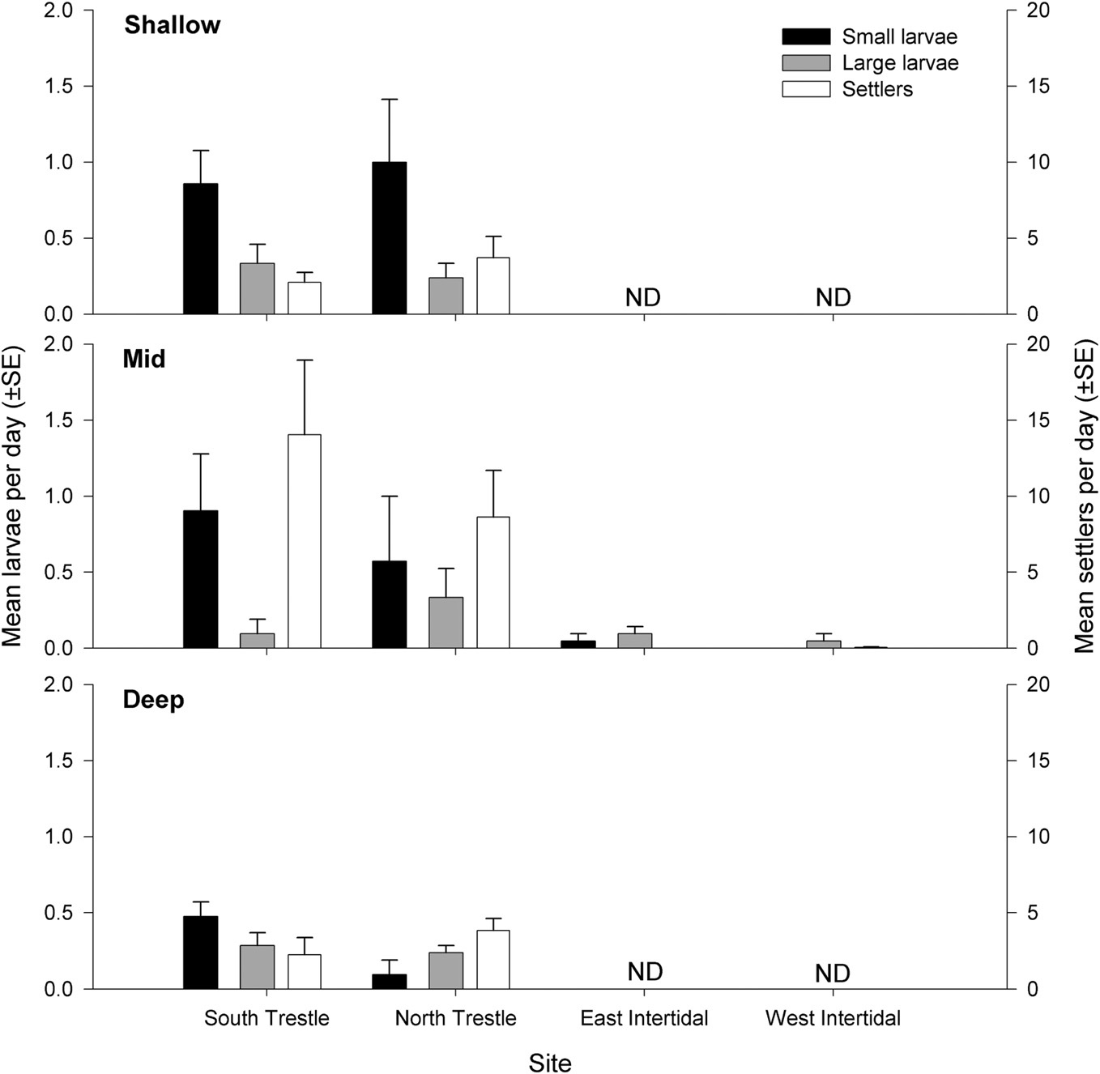

Slide 15
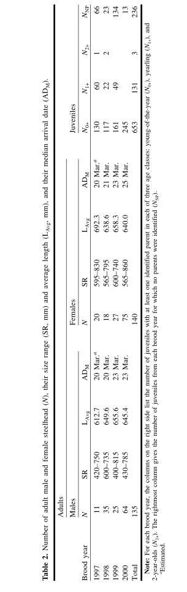


Slide 16

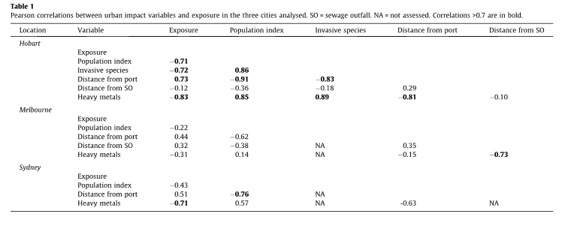

Slide 17
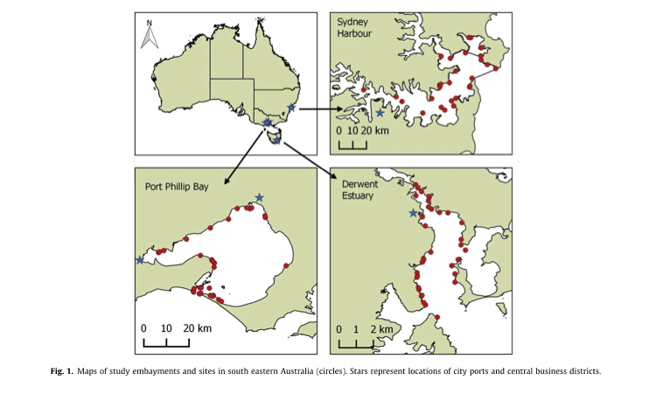

Slide 18
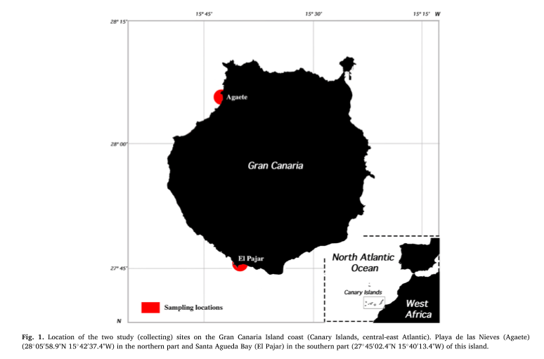
Fig. 1. Location of the two study (collecting) sites on the Gran Canaria Island coast (Canary Islands, central-east Atlantic). Playa de las Nieves (Agaete) (28◦05′58.9"N 15◦42′37.4"W) in the northern part and Santa Agueda Bay (El Pajar) in the southern part (27◦45′02.4"N 15◦40′13.4"W) of this island.

Slide 19
Figures and tables: more rules and conventions
Figures and tables are numbered consecutively, in separate series
Figure 1; Figure 2; Figure 3; Table 1; Table 2; Table 3
Can re-use numbers for a figure and table, but not two figures or two tables
All figures and tables must be referenced in body
“Grain size was large at the inflow and decreased farther out (Fig. 1).”
Avoid “Fig. 1 shows differences in grain size”.
Figures and tables are numbered in order of their appearance in the body
Abbreviate in-text citations (Fig. 1) and write out in caption (Figure 1). “Table” is never abbreviated.
Figures and tables are given at the end of a manuscript, after references. One item per page.
The journal staff arrange them if your manuscript is accepted
Tables should be formattable in Word- do not use a picture of a table. Paste from Excel.

Slide 20
Checklist for your tables and figures
Is every table and figure necessary?
Can a sentence work instead?
Are any figures/tables redundant with each other (showing same result)?
Does every figure show the correct independent/dependent variable?
Do you use a figure to show a pattern, trend or relationship? Do you use a table when the precision matters and you are showing many variables?
Is every figure/table and its caption understandable without referring to the body?
Are figures and tables numbered consecutively in separate series?
Is every figure/table referred to in the body?
Are figures numbered according to the order they appear in the text?
Does every figure/table have a caption? Does the caption appear below figures and above tables?
Are figures and tables given at the end of the manuscript?

Slide 21
More guidelines for the Results section
You should be able to read the text without looking at the tables and figures and still understand the paper. Do not rely on figures to tell the story. Figures are enhancements!
For each result you give in this section, there should be a corresponding set of methods in the preceding section
Just the facts: save biological interpretation for the Discussion
Numerical interpretation good:
“The mean mercury concentration of landlocked salmon was higher than seagoing salmon (mean=, p value).” (this is a fact)
Real-world interpretation bad:
“This suggests that landlocked salmon live in more contaminated environments than seagoing salmon.” (this is not a fact)

Slide 22
Even more guidelines for the Results section
The Results section is usually short (remember- just the facts!)
Good idea to give a one or two-sentence summary of the results, either as the first (preferably) or the last sentence
If there are multiple experiments or types of analyses, good idea to group under subheadings that match the Methods subheadings.
Always use the past tense!

Slide 23
Assignments for today and for home
In class:
Work on the Results section of your paper. You will submit intro, methods, results and one figure on Friday.
Outside of class:
Work on the Results section of your paper. You will submit intro, methods, results and one figure on Friday.
Watch videos on “better poster”.
Find a poster around FSH, FTR, MAR or elsewhere, take a photo of it, and submit it on canvas alongside three positive comments and three ideas for improvement.
Next class, we will shift gears to discuss your poster project.

